Slide 1
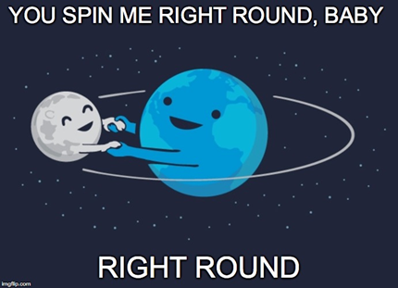
Gravity in the Galaxies Day 2
11/15 & 11/16

Slide 2
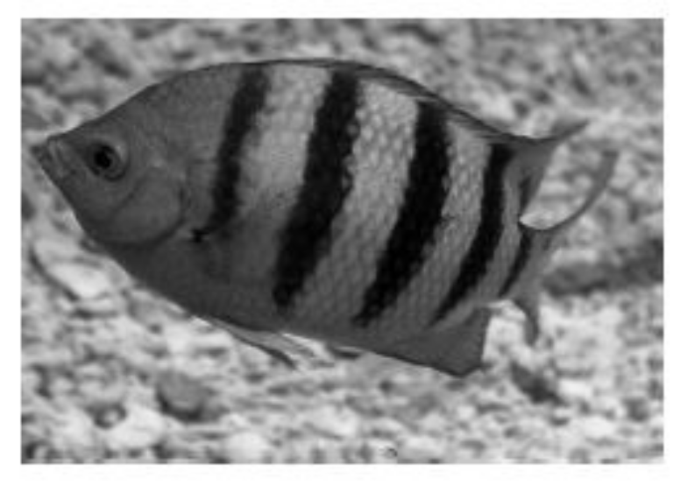
DQ
A damselfish has a compressed body shape, making the fish appear flat.
The fish swims forward, causing an action force by the fish on the water. How does the damselfish’s
body shape affect the strength of the reaction force from the water on the fish as it swims forward?
A The body shape causes the reaction force from the water to affect only the tail fin which is a larger area on the fish.
B The body shape causes the reaction force from the water to affect the head which is a smaller area on the fish.
C The body shape causes the reaction force from the water to decrease when the fish swims deeper into the water.
D The body shape causes the reaction force from the water to increase as water flows around the
fish’s body.

Slide 3

What causes tides? (take notes on notebook paper)
High and low tides are caused by the moon. The moon's gravitational pull generates something called the tidal force. The tidal force causes Earth—and its water—to bulge out on the side closest to the moon and the side farthest from the moon. These bulges of water are high tides
8ESS1.2

Slide 4
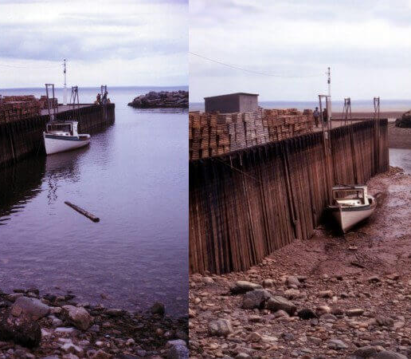
High tides and low tides
High tides and low tides are caused by the moon. The moon's gravitational pull generates something called the tidal force. The tidal force causes Earth—and its water—to bulge out on the side closest to the moon and the side farthest from the moon. These bulges of water are high tides.
8ESS1.2

Slide 5
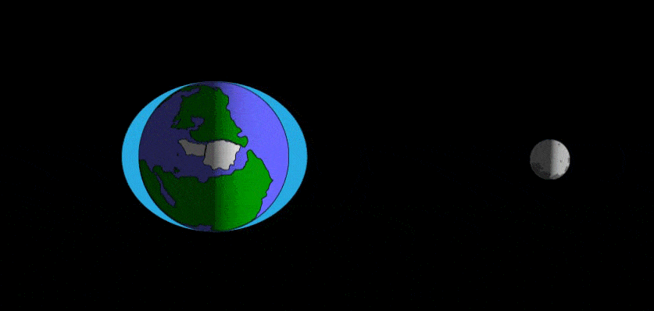
This shows the tidal force in a view of Earth from the North Pole. As regions of Earth pass through the bulges, they can experiences a high tide.
As the Earth rotates, your region of Earth passes through both of these bulges each day. When you're in one of the bulges, you experience a high tide. When you're not in one of the bulges, you experience a low tide. This cycle of two high tides and two low tides occurs most days on most of the coastlines of the world.
For more information about tides click here.
8ESS1.2

Slide 6
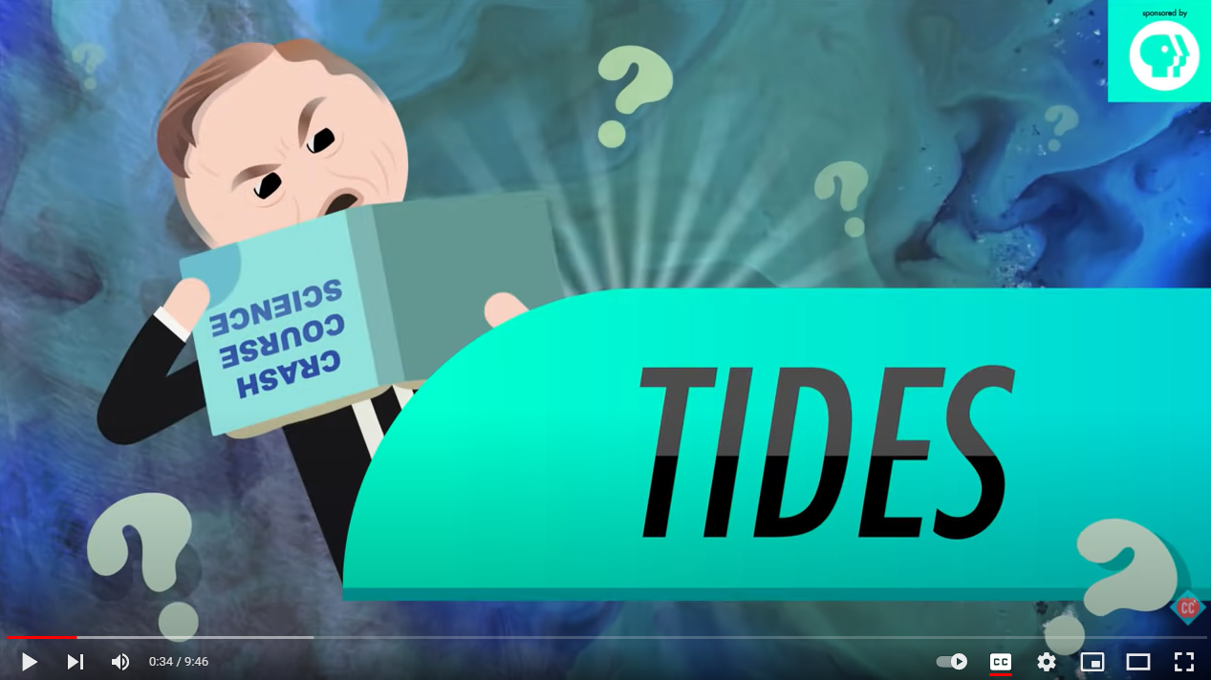
8ESS1.2

Slide 7
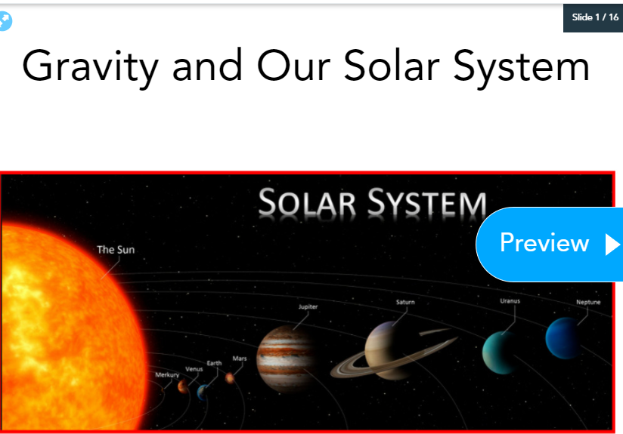
Nearpod – Gravity and Our Solar System
Complete the nearpod with the following code:
1st period LV8RU
2nd period KACQN
3rd period QDPLW
4th period EW9TJ
6th period VKHAI
7th period GBEHR
Once you finish the nearpod, complete textbook pages 166-173 – We will check these during our next class period.

Slide 8
Exit Ticket
How does the moon affect tides?

